Slide 1

Fine Grained Vehicle Classification
EGR 598 CONNECTED AUTOMATED VEHICLES
SCOPE PRESENTATION
Supporting the IAM Metrics Project, Camera / LIDAR Fusion-Based Algorithm Team
Sponsors:
Dr. Yexhou Yang,
Dr. Hongbin YU,
ASU
Manohar Akula
1223335191

Slide 2
Outline
Project Objectives
Description
Requirements
Deliverables
Doesn’t Include
Success
Estimated Schedule

Slide 3
Project Objective:
The aim of the project is to support the IAM Metrics Project, Camera/Lidar Fusion Algorithm team and developing a classification model to classify vehicle types and models using monocular images.
Project Sponsor: Dr. Yezhou Yang and Dr. Hongbin Yu, ASU

Slide 4
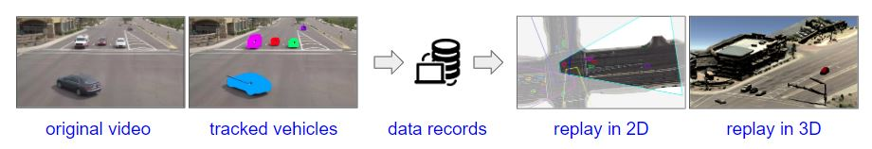
Project Objective Cont:
CAROM is a framework to track and localize vehicles using monocular traffic monitoring cameras on road infrastructures.
Resource: https://docs.google.com/presentation/d/1JnwyEy6sARgipX_6YOxAhrU7-aJkrDnxM5dXtM79EM4/edit#slide=id.gd9d16281fd_0_0
The vehicle localization results are stored in files or in a database as records. Using the results, a traffic scene can be reconstructed and replayed on a map.

Slide 5
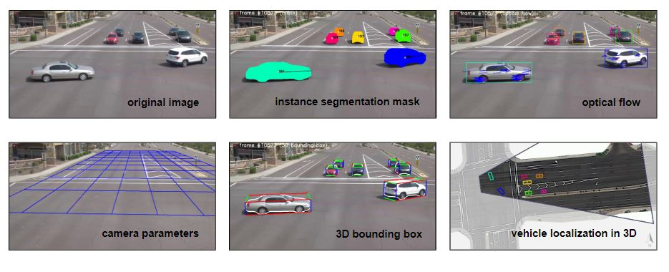
Project Objective Cont – Vehicle Tracking and Localization :
Resource: https://docs.google.com/presentation/d/1JnwyEy6sARgipX_6YOxAhrU7-aJkrDnxM5dXtM79EM4/edit#slide=id.gd9d16281fd_0_0
Note: Please keep in mind that I am not a member of the tracking or localization teams. The graphics above are presented to help you understand what initiative I am supporting.

Slide 6
Project Description:
This project aims to utilize images from Carvana, a Phoenix-based online dealer of used cars, to train and test a multi-class classification model to recognize different vehicle kinds and well-known vehicle models.
This will be accomplished by developing a web scraping algorithm to extract images of a vehicle model from the Carvana website from various view angles and label these images

Slide 7


Project Description – Work Flow:
Dataset Creation
CNN Model
(Test, Train and Validation)
Hyperparameter Training
Accuracy Evaluation
Carvana Website
Developing Web Scraping Algorithm
Image Extraction

Slide 8
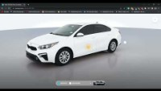
Project Description – Carvana dataset creation:

Slide 9
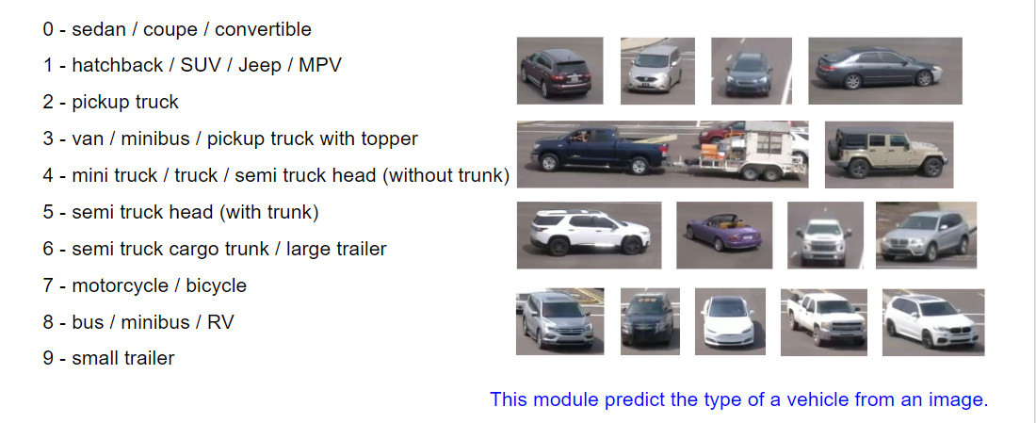
Type of Cars used for training:

Slide 10
Project Requirements:
In depth understanding of Statistics, Deep Learning, Machine Learning, and Web scraping Algorithms.
Image Labeling.
Building dataset with the appropriate train, test, and validation.
Training CNN model.
Hyper Parameter Optimization.

Slide 11
Project Deliverables:
A vehicle Classifier Model.
A Neural Network that can predict the vehicle type for model-based tracking/dimension estimation.
The study will also concentrate on developing a dataset for the issue statement that may be applied to other applications in the future
A 20 pages report, Code and Presentation.

Slide 12
Project Doesn’t Include:
The model is not able to predict all vehicles and vehicle types
The model will only output one class because it is a multiclass classifier rather than a multilabel classifier

Slide 13
Success / Acceptance Criteria:
Vehicle classification should be accomplished by the model quickly and with high confidence. For the model to be used in the IAM metrics team's work, it must satisfy their requirements.

Slide 14
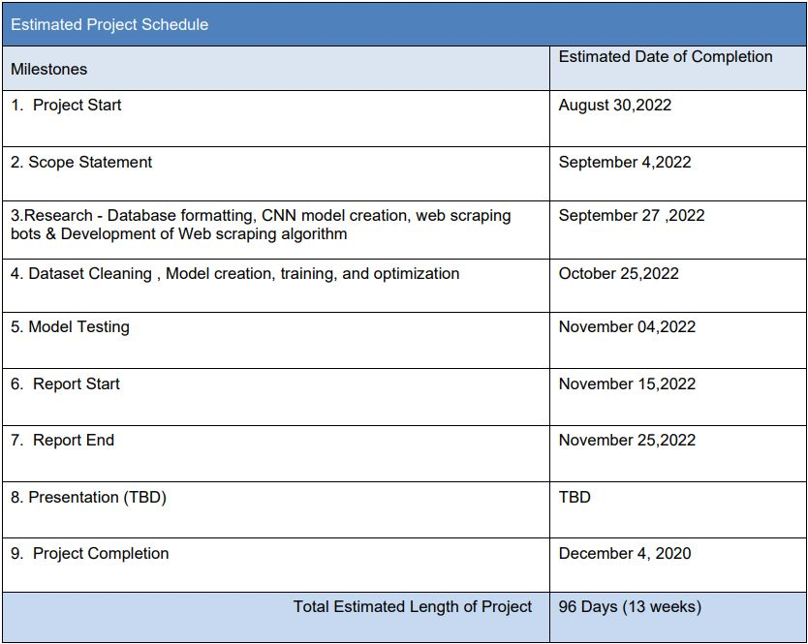
Schedule / Timeline:

Slide 15
Thank You

